Slide 1
Model-based Integrated Planning and Control of Autonomous Vehicles using Artificial Potential Fields with uncertain environment
Emilio Benenati
Josyula Viswanath Das
24th September 2021

Slide 2
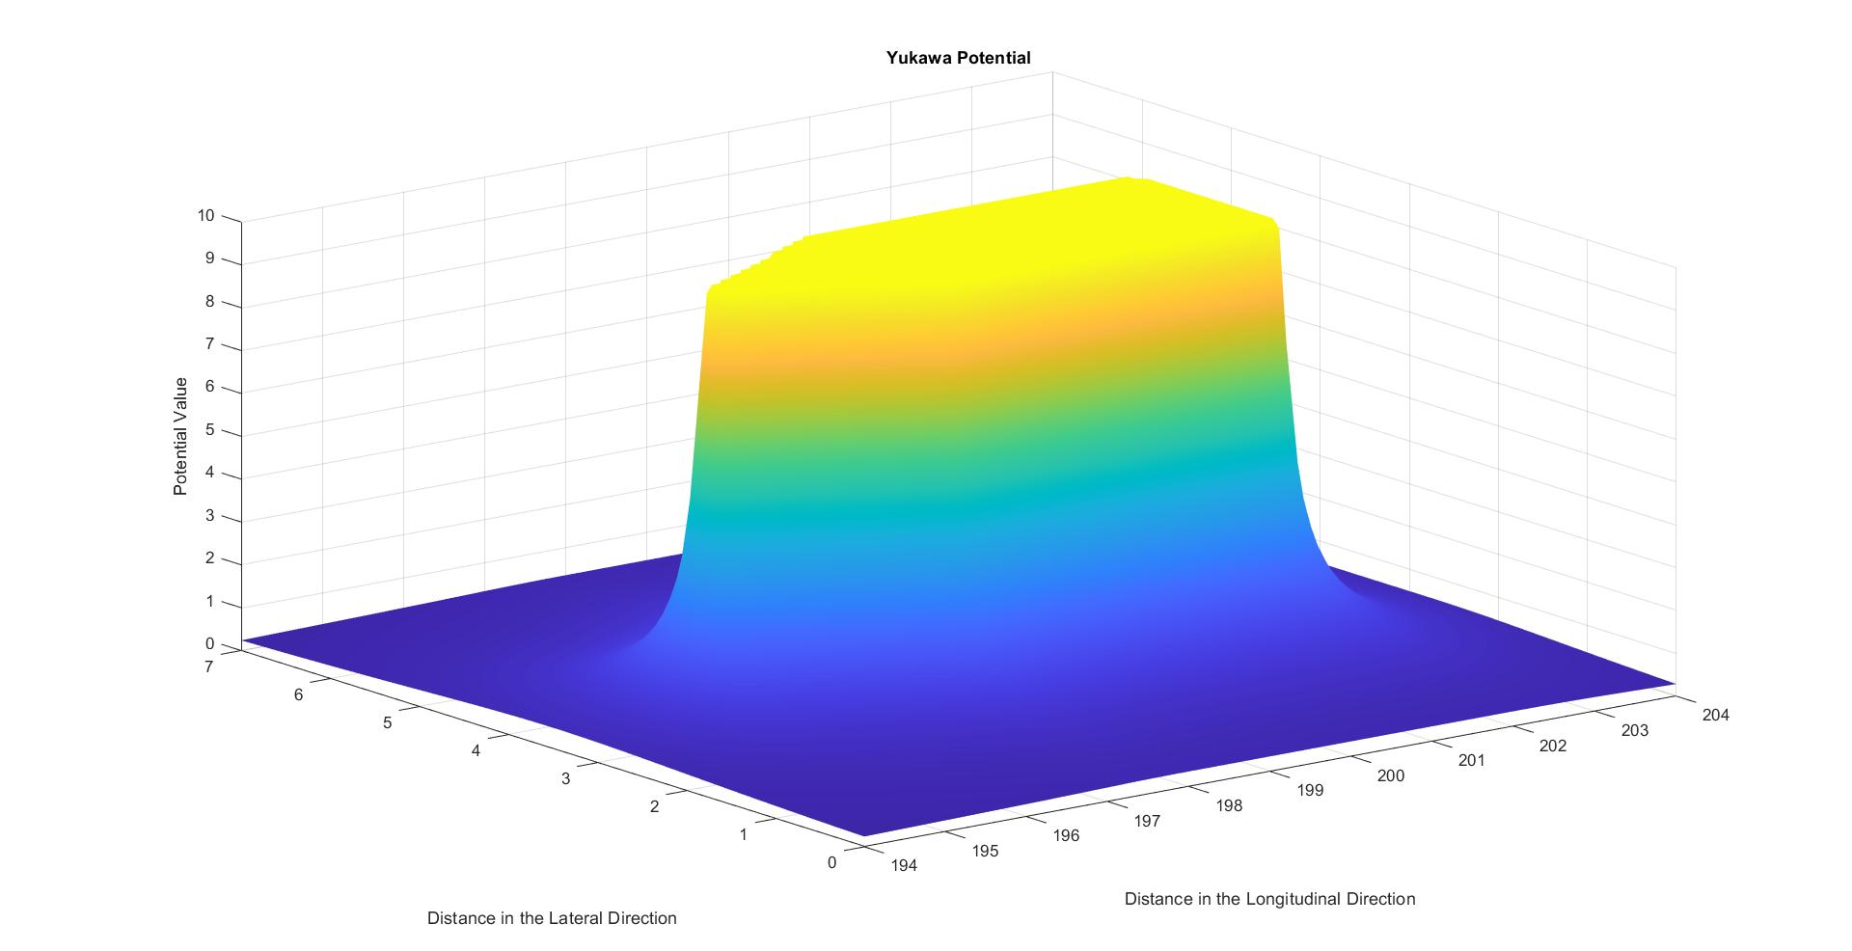
Yukawa Potential

Slide 3
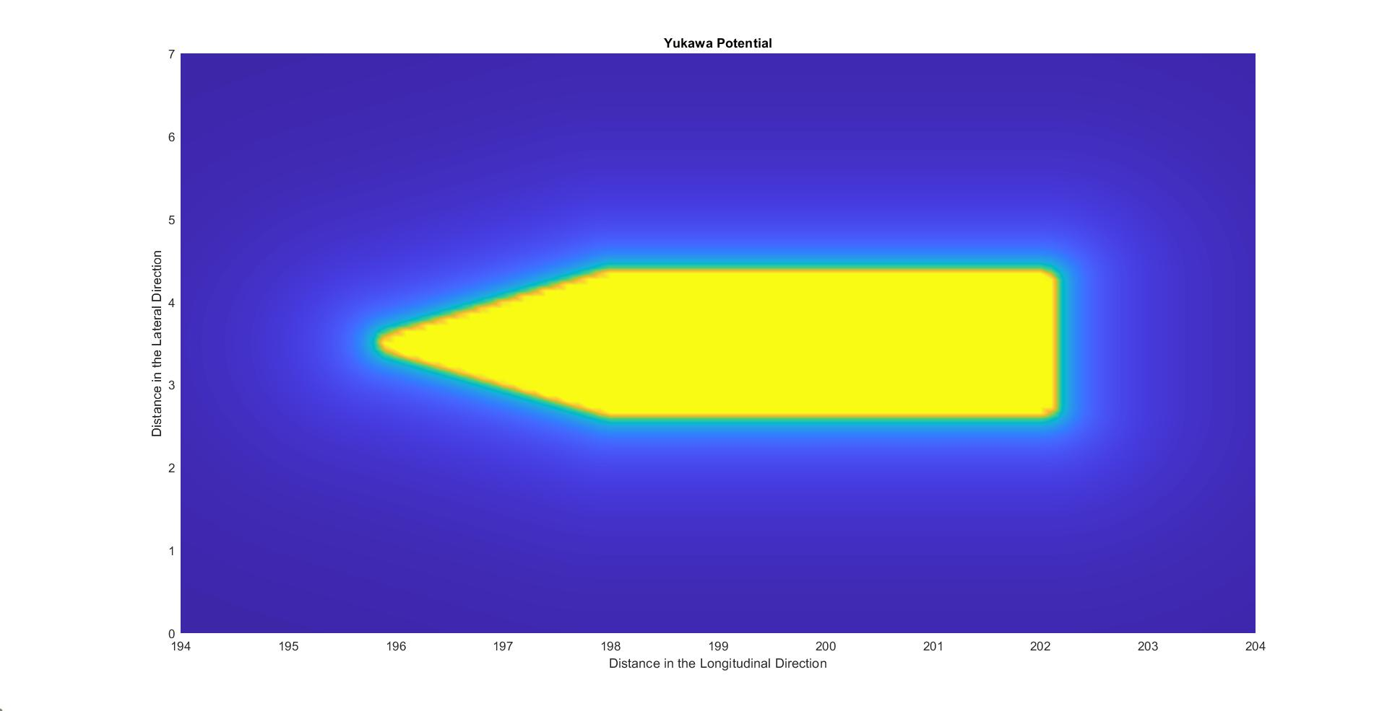

Slide 4
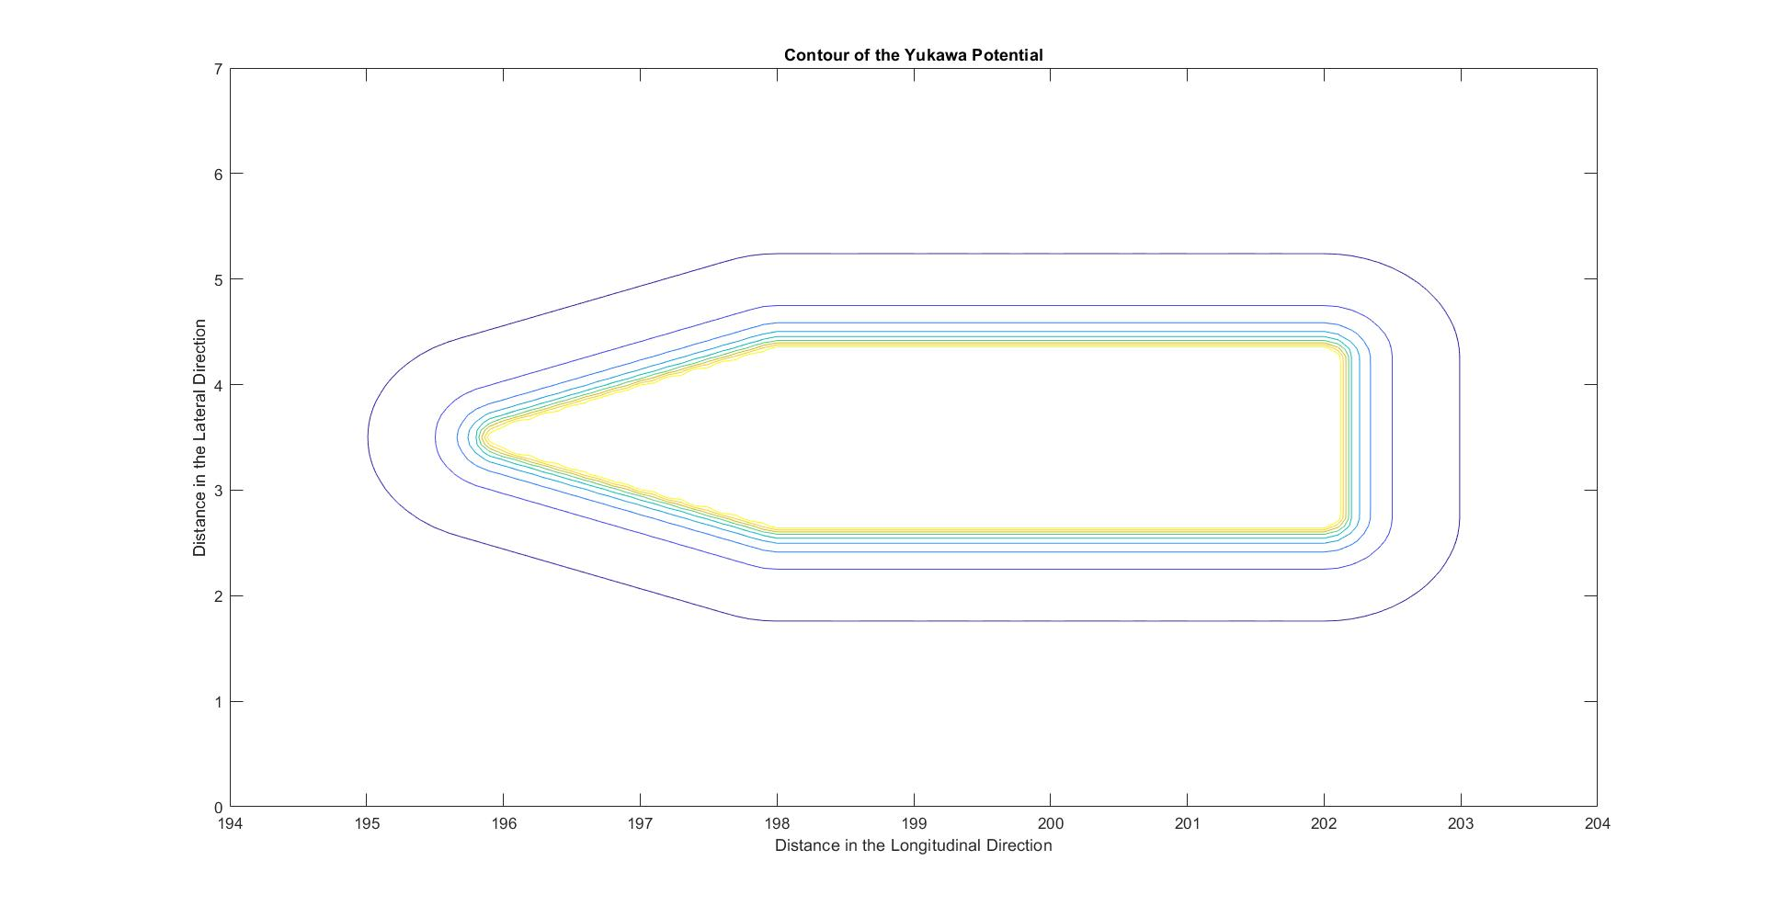

Slide 5
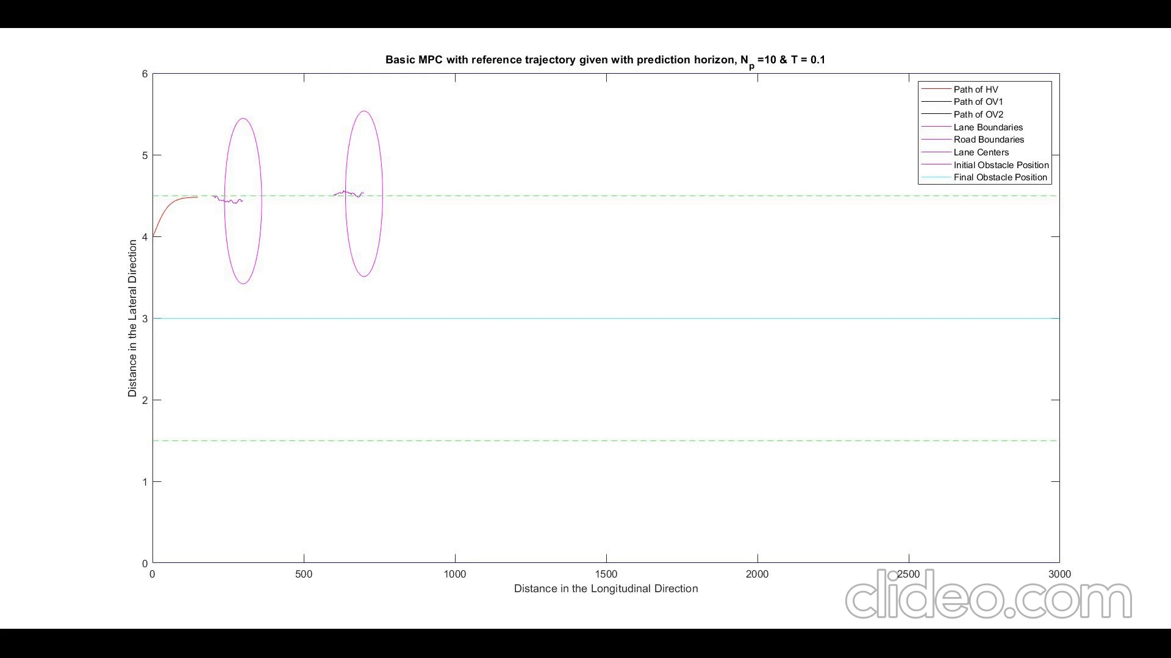
MPC-APF with Kalman Filter

